Slide 1
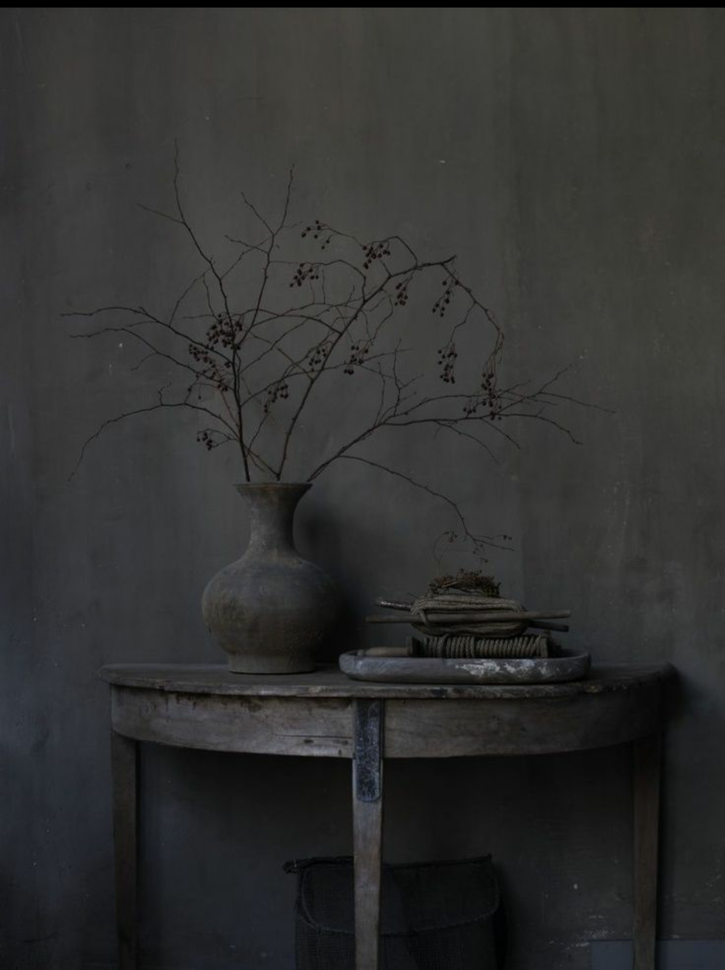
Nocchi 161 KINGSBARN Enter

Slide 2
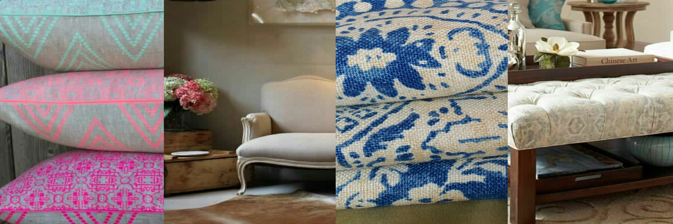
Nocchi Home About Us Shop Nocchi Contact Insert caption of all products here….e.g.….

Slide 3
Nocchi Shop Nocchi Furniture Bedding Cushions Kids sofa Sheets Floral/Patterned Cushions Duvets coffee tables Pillow cases Long Cushions Sheets headboards Duvet covers Plain Cushions Pillow cases Scatter pillows

Slide 4
Nocchi About Nocchi Nocchi is a store for the discerning, quality-conscious buyer of beautiful and unique home accessories and furniture. The store prides in creating one-of-a kind pieces with quirky fabrics that will transform your home. Nocchi seeks to inspire people to express their individuality through creating affordable pieces that can bring character to any space.

Slide 5
Nocchi Contact Us Visit our store at 161 Kingsbarn Jackal Creek Estate Boundary Road Northriding. Tel: 011 513 3461 Email: info@nocchi.co.za

